Slide 1



Welcome to MEAN-Stack Level 1
by
Ahmed Zayed
Consultant and Trainer in Software Development Solutions and Digital Marketing
www.ahmedzayed.net

Slide 2
Get to Know Our Amazing Trainees!
Welcome to the beginning of our new story as developers, where curious innovators, creative thinkers, and dedicated learners come together to master the MEAN stack and transform their careers!

Slide 3

Meet Your Instructor
LinkedIn
Name: Ahmed Zayed
Website: www.ahmedzayed.net
Experience: Over 18 years specializing in software development and digital marketing
Background: Expert consultant and trainer known for delivering transformative strategies and solutions
Skills:
Front-End: Mastery in HTML, CSS, JavaScript, jQuery, Angular CLI for creating engaging user interfaces
Back-End: Proficiency in .NET framework with C#, ASP.NET (Forms, MVC, Core), Node.js, and robust RESTful APIs
Database: Expertise in MS SQL, MySQL, and MongoDB for scalable data solutions
DevOps: Agile/Lean development, software design, and meticulous requirements analysis
Digital Marketing: Strategic SEO, comprehensive digital marketing planning, compelling content strategies, and effective digital advertising campaigns
Additional Skills: Innovative UI/UX design, distinctive logo and graphic design, adept with React.js for dynamic web applications
Certifications and Education:
Bachelor of Business Administration, Ain Shams University
Microsoft Certificates Application Developer (MCAD)
Specialized certifications from leading institutions like Coursera in areas from secure software design to advanced digital marketing strategies
Freelance Experience: Successfully managed diverse projects over 11 years as a freelancer, delivering excellence and innovation for startups around the world

Slide 4
About the course
Level 1 (15 Sessions)
Part 1:Establishing 4 Sessions (introduction, JS, OOP, TypeScript)
Part 2:Front End 6 Sessions (Angular)
Part 3:Back End 5 Sessions (MongoDB, Express JS, Node JS)
Course Project 1 Session

Slide 5
Introduction

Slide 6
The Story Of Websites
Programming History
ARPA
1990 first website, 1992 Images, 1992 Mosaic the first browser.
The Netscape revolution 1993.
HTML , JS 1995 – CSS 1996

Slide 7
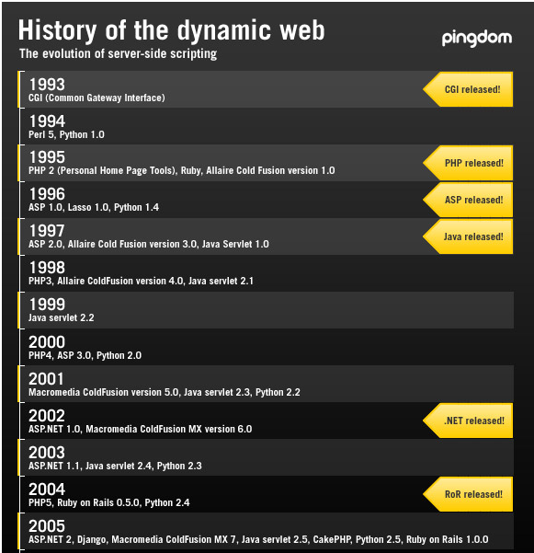
Source: https://www.pingdom.com/blog/a-history-of-the-dynamic-web/

Slide 8
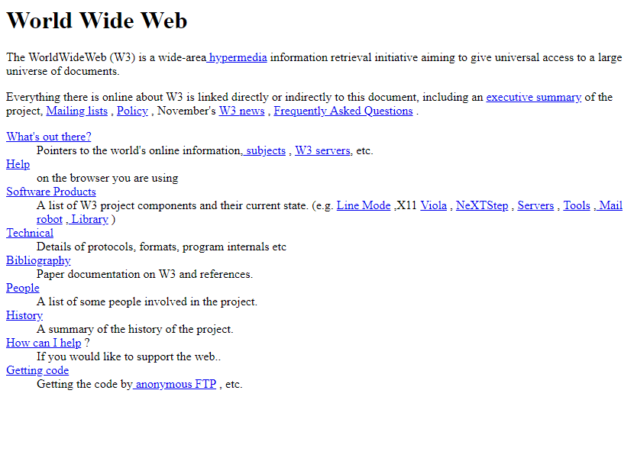
Old Websites
First Website 1991
Source: https://www.webdesignmuseum.org/exhibitions/the-world-s-first-website-1991

Slide 9
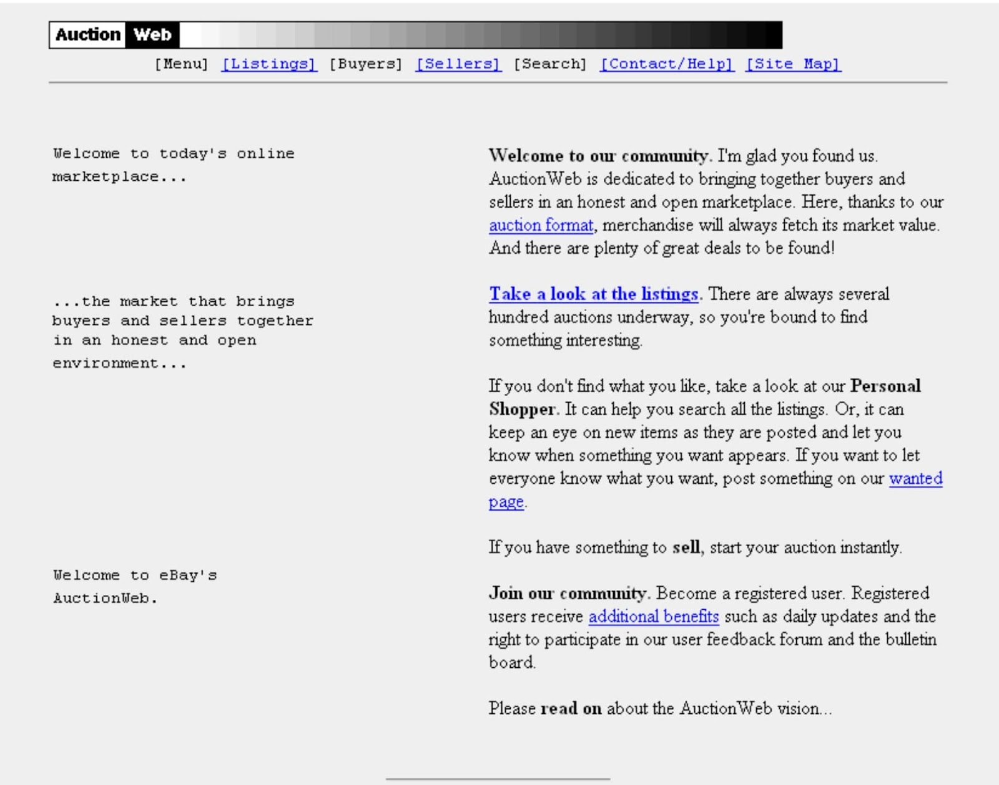
AuctionWeb (eBay)
In 1995, auctions went virtual. AuctionBay — later changed to eBay — was a weekend coding project that turned into an internet staple.
Source: https://webflow.com/blog/90s-website-design

Slide 10
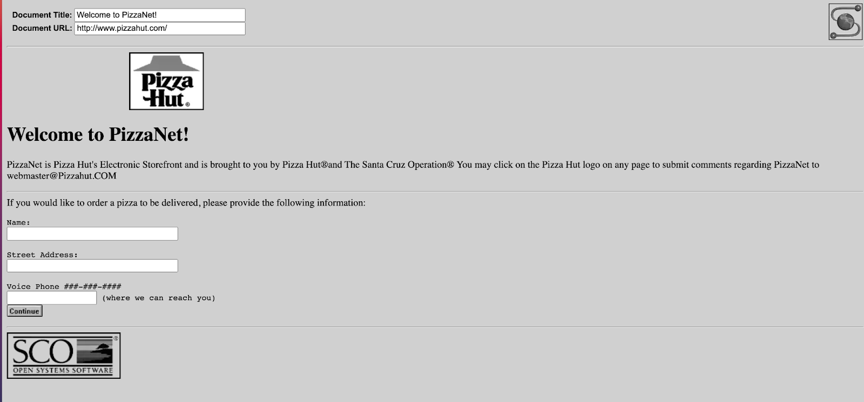
PizzaNet
This experiment by Pizza Hut hit the world wide web in 1994
Source: https://webflow.com/blog/90s-website-design

Slide 11
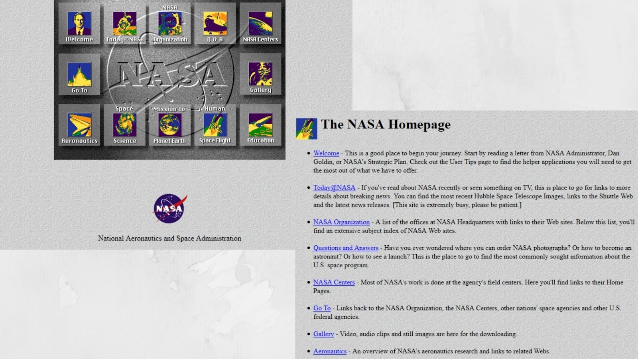
NASA
The National Aeronautics and Space Administration (NASA) launched the first iteration of its site in 1994
Source: https://webflow.com/blog/90s-website-design

Slide 12
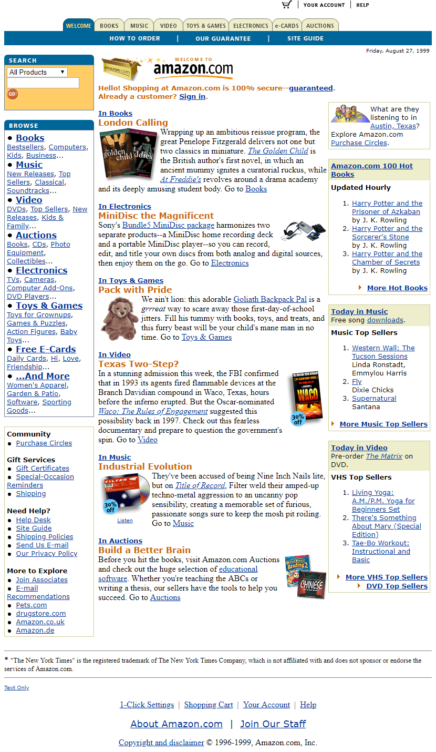
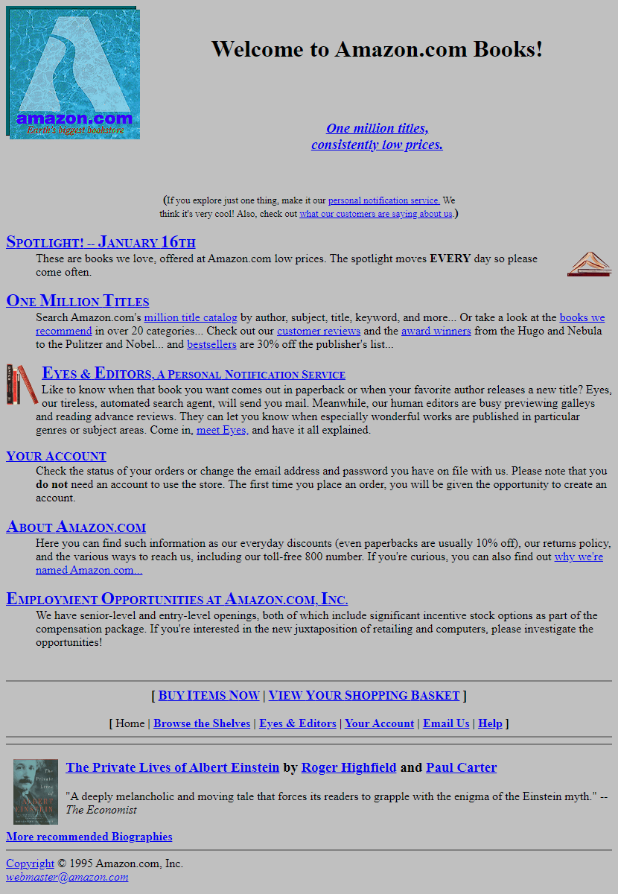
Amazon
1994
1999
Source:
https://www.webdesignmuseum.org/exhibitions/amazon-1995
https://www.webdesignmuseum.org/gallery/amazon-1999

Slide 13
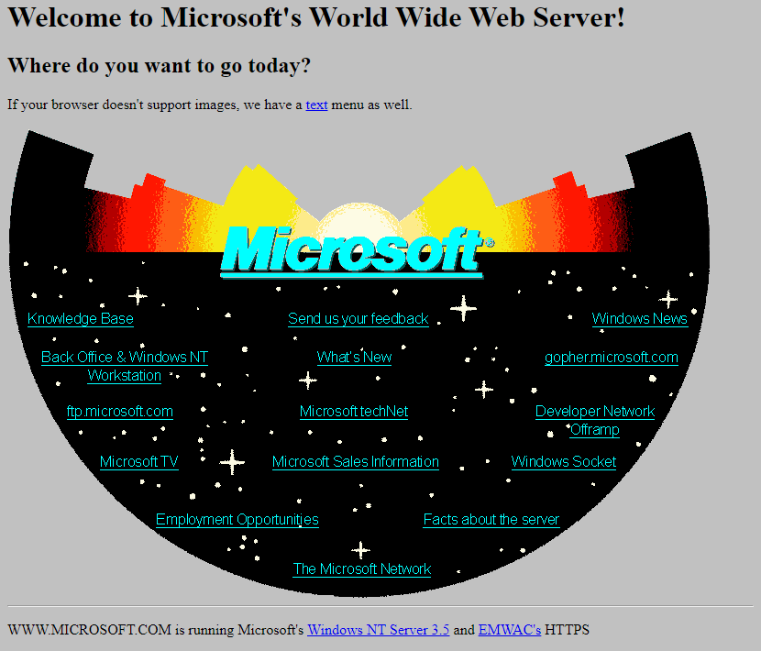
Microsoft 1994
Source: https://www.webdesignmuseum.org/exhibitions/microsoft-1994

Slide 14
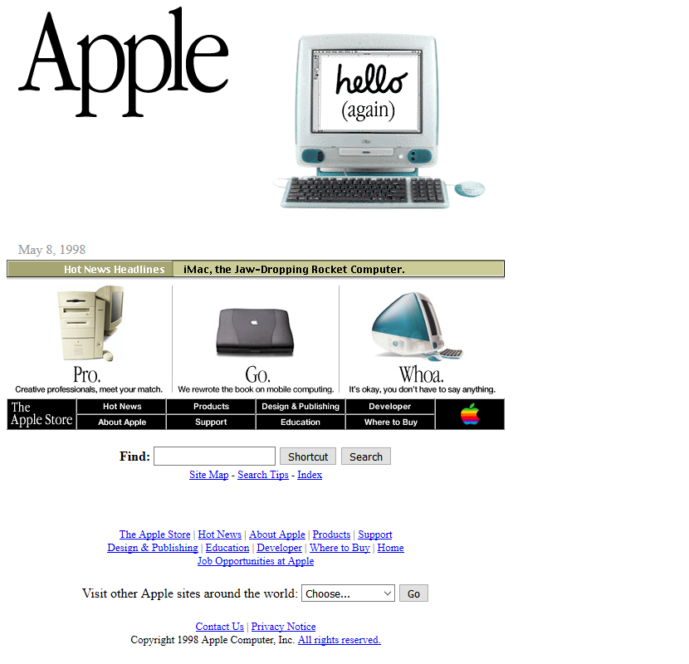
Apple 1998
Source: https://www.webdesignmuseum.org/exhibitions/apple-1998

Slide 15
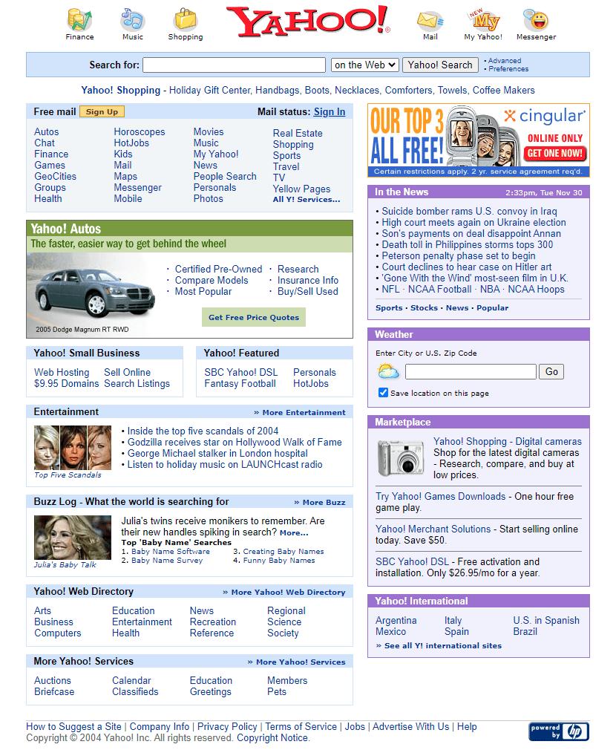
Yahoo 2004
Source: https://www.webdesignmuseum.org/gallery/yahoo-in-2004

Slide 16
JS Old Uses ….
Do not be surprised ;)

Slide 17
Source:https://blog.logrocket.com/20-web-design-relics-of-the-old-internet-eb3df4ac13e7/

Slide 18
Source:https://www.pinterest.com/pin/old-web-nostalgia--769130442601996155/

Slide 19
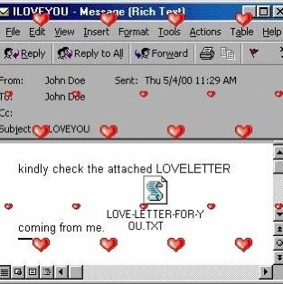
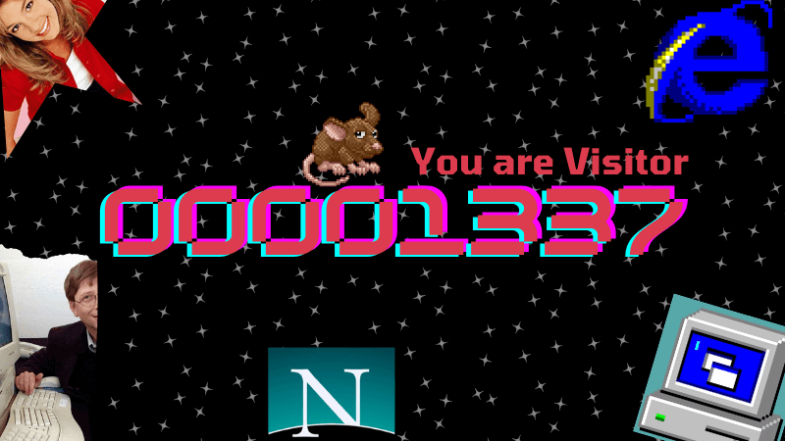
Source: https://www.pinterest.com/pin/8444318045424420/
Source:https://www.pinterest.com/pin/33214115995255264/
Source:https://wideangle.co/blog/visitor-counter-geocities-and-the-90s

Slide 20
Modern Websites

Slide 21
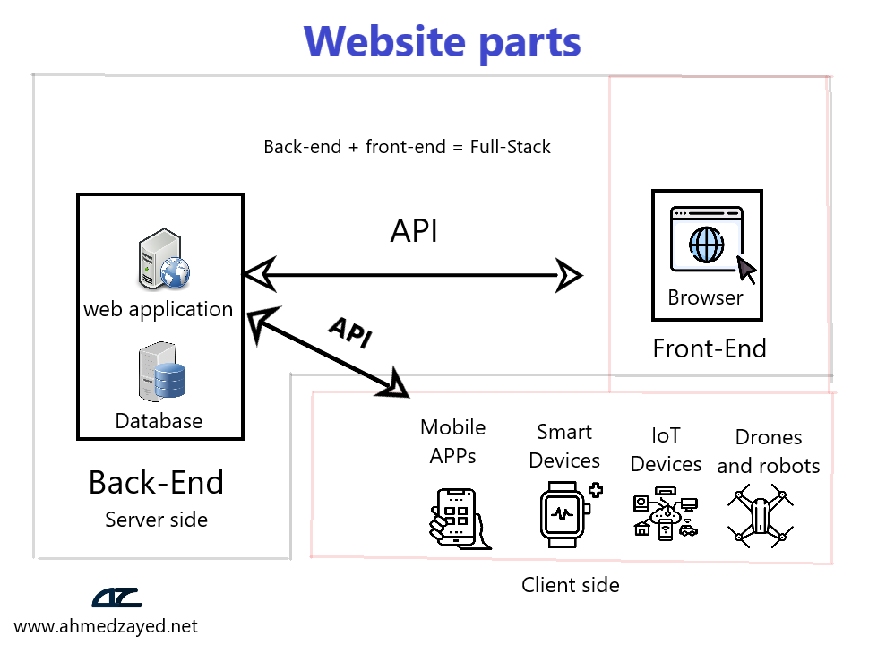

Slide 22
Websites job roles

Slide 23
UI Design
Job Description:
Selecting the site's layout, colors, fonts, images, and colors of various elements.
Tools:
Design tools like Photoshop, HTML, CSS, JavaScript

Slide 24
UX Design
Job Description:
Determining the placement and usability of various elements. For example, a UI designer selects the location of a "buy" button in an e-commerce site, while the UX designer ensures it's easy for users to find and use.
Tools:
HTML, CSS, JavaScript, UX testing and surveys, marketing analysis tools

Slide 25
Front-End Programming
Job Description:
Programming tasks that occur in the user's browser.
Tools:
JavaScript (frameworks), HTML, CSS

Slide 26
Database Design and Programming
Job Description:
In small to medium projects, one or more people might handle designing, creating, and programming databases. In larger projects, these tasks are often divided among specialists.
Tools:
Databases like MySQL, MS SQL, MongoDB, and related tools

Slide 27
Back-End Programming
Job Description:
Programming tasks that occur on the server, usually involving databases or application files shared among users.
Tools:
Back-end programming languages and frameworks such as C# with ASP.NET or JavaScript with Node.js

Slide 28
Website Security
Job Description:
Security tasks are multi-faceted, involving code-level security, server and database security, and data security. In large projects, specialists handle each of these tasks.

Slide 29
Server and Hosting Management
Job Description:
Configuring server settings and website files, ensuring the website runs efficiently and quickly.

Slide 30
SEO Optimization
Job Description:
No matter the effort put into designing and developing a site, it's invisible to users who don’t know its domain name. SEO makes the site visible to search engines, involving basic setup by the front-end developer and further optimization by a digital marketing specialist.
Tools:
HTML, CSS, JavaScript (not necessarily proficient, but should have a general understanding)

Slide 31
Content Management
Job Description:
Creating or editing content segments such as text, images, videos, or other types of content, based on the site’s nature and purpose.
Tools:
Content management through a control panel, part of the front-end interface, used only by authorized users

Slide 32
User Management
Job Description:
Adding, modifying, and deleting users, and assigning permissions to each user or user group.
Tools:
Website control panel

Slide 33
About the course
Freelance
Full-Stsck
MEAN

Slide 34
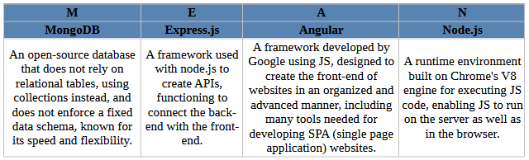
MEAN

Slide 35
FAQ
Which language should I start studying?
What are the most in-demand languages in the job market?
Are there jobs for front-end developers?
Do I need to be excellent in mathematics to study programming?
Do I need to be proficient in English?
What skills are required to be an outstanding programmer?
Which framework has the most job opportunities?
What are the characteristics of a good website?
Do I need to be a graduate of a Computer Science faculty to work as a programmer?
Can I build a foundation solely with JavaScript?
Will programming jobs decrease because of artificial intelligence?
What types of websites can I create after completing this course?

Slide 36
Tools we will use
Visual Studio Code (VS Code)
Node JS
Postman
Text Editor like (Notepad++)

Slide 37
JavaScript

Slide 38
Uses
Websites
Desktop applications
Mobile applications
Applications for smart devices like watches and TVs
IoT applications (Internet of Things)
Applications that control robots and drones
Game development

Slide 39
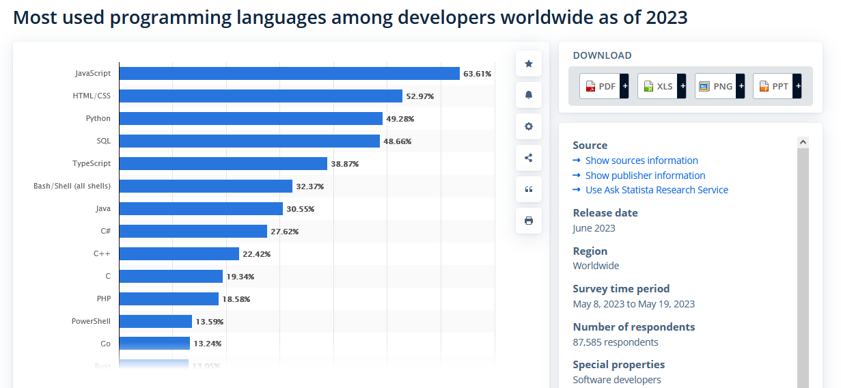
Source: https://www.statista.com/statistics/793628/worldwide-developer-survey-most-used-languages/

Slide 40
JS Fundamentals
Window Object
Document Object
Primitive data types
Number
BigInt
String
Boolean
Undefined
Null
Symbol

Slide 41
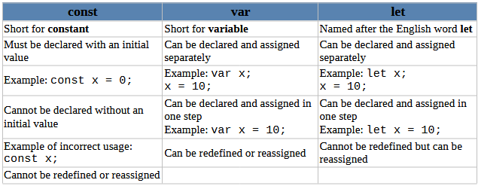
Variables

Slide 42
Number, String And Date

Slide 43
Conditional statement
If
Comparison Operators
==, ===, !=, !==, >, <, >=, <=
Logical Operators
&&, ||, !
Switch

Slide 44
Loops
for
while
do while

Slide 45
Thank you

